Slide 1
So that was Backbone. How do the others compare?
 | Backbone | Spine | Ember | Javascript MVC | Knockout
Models | X | X | X | X
Views | X | X | X | X
Controllers | X* | X | X | X
Collections | X |  | X
History/ Hash stuff | X | X |  | X

Slide 2
So Knockout Kinda Belongs Anyway
 | Backbone | Spine | Ember | Javascript MVC | Knockout
Models | X | X | X | X | X*
Views | X | X | X | X | X*
Controllers | X* | X | X | X | X*?
Collections | X
History/ Hash stuff | X | X |  | X

Slide 3

Dependency management
Deployment tools
Testing
Documentation

Slide 4
Ramp-Up Effort

Slide 5
Features

Slide 6
And There Is More
Batman.js
Angular.js
Mamoo

Slide 7
So Where Do You Go From Here?

Slide 8

Read This

Slide 9
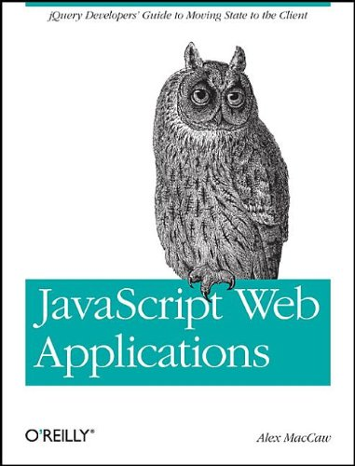
Read This

Slide 10
Try one or two (or more)

Slide 11
Build something non-trivial

Slide 12
Study their source code

Slide 13
Then, if you really want to be hardcore, build one ☺

Slide 14
My Stuffz
Email: eric.sowell@gmail.com
Twitter: @mallioch
Web: http://ericsowell.com
https://github.com/Mallioch/virtual-quiz-card
https://github.com/Mallioch/Presentations

